Slide 1

Unlocking and financing gender just-climate solutions with energy cooperatives
Potential of energy communities to meet emission targets and enable access to affordable, decentralized and renewable energy, focusing on gender-just participation and women’s empowerment

Slide 2
Climate financing fails to reach local level
Only about 10% of available climate finance reaches local level
Barriers preventing global development finance from reaching the local level:
Metrics of success
Business-as-usual intermediaries
Limited support to build local capacity to manage funds and technologies
Risk-averse funding
Inappropriate co-financing targets
Poor oversight of policies
Source: IIED (2017): Delivering real change - Getting international climate finance to the local level
Notes:
Clean Technology Fund (CTF) and the Green Climate Fund (GCF) primarily judge projects on the tonnes of carbon reduced and the mobilisation of private co-finance, all of which incentivise large energy investments. This deprioritises services to the local level.
If the numbers of people with access to energy were given greater weight, decentralised energy programmes could gain greater investment and provide poor. communities with access to energy faster.
Local management capacity is often a barrier to financing, with concerns over financial mismanagement.
To be effective, climate and sustainable development interventions must take place at every level. Evidence suggests that this is not happening and that too little finance is reaching local communities. Action needs to be taken to address this imbalance. By both reforming how the finance is tracked and the funding architectures, climate and development finance could deliver improved results to those who need it most.

Slide 3
Notes:
It is easier to integrate the development and climate agendas at the local level. This is achieved where local stakeholders are engaged in participatory decision making – empowering local communities and small and medium-sized enterprises (SMEs) to decide what investments are most needed to achieve low-carbon, climate-resilient development. Inclusive and agile local institutions can be effective agents of development as local people know their context best and are able to respond rapidly to changing local circumstances.

Slide 4


Community Energy - unlock climate finance?
Big investments are important, but investors using local resources mainly for their profit
vs.
Local communities and financing using local resources (sun, biomass, wind, water) for own consumption, and growing local economy, produce more sustainable results and provide access to clean energy
REBOOT
THE SYSTEM

Slide 5
Key findings I
Countries have much to gain from a regional approach for energy security
Available data on energy citizen projects is limited
Energy cooperative projects do not stand alone, part of comprehensive ‘community developing’ policy (large number of beneficiaries)
Community projects don‘t have or avoid negative impact on environment
Insufficient knowledge to understand the extent this form is able
          to unify a broad group of actors to promote RE: societal power,
    to gather capital for elaborating renewable energy supply structures: economic power
    to meet international climate and SDG targets: ecological power
Notes:
High need to strengthen public energy administrations to develop strategies and implement policies: market regulation, energy efficiency, energy security, energy poverty and ecological impact of energy use
Energy coops as intermediaries for a broad public consultation.
The countries have much to gain from a regional approach of RE to energy security and greater integration of markets.
Geographical situation

Slide 6
Key findings II
National climate and energy policies
Degree of gender equality
Situation and power of civil society
Legal framework for coops
All countries ratified the Paris Agreement and have GHG emission reduction and RE targets
All target countries recognize the legal form of cooperatives, yet energy cooperatives remain uncommon
Existing pilots, business models and technologies
In all countries – except Belarus – initiatives have already started small-scale decentralized RE projects with public participation
Energy communities could assist in meeting the objectives of the UN agreement
Gender budgeting is used in pilots just in Ukraine, Moldova and Serbia.
Gender mainstreaming is included in some National Strategies on Gender Equality
Similar challenges with addressing gender inequality. Existing instruments are often not in practice
Low trust (including trust in non-profits) by influx of non-indigenous forms of civil society
Strong correlation between socio-economic development and the overall enabling environment for civil society
Lack of knowledge and missing support are main barriers
Still struggling with strong monopolistic structures, lack of funding and experience in the model, they show reasonable and successful energy solutions
Notes:
Western Balkans have subcribed to the energy community treaty which aims to create a regional energy market compatible with the internal energy market of the EU.
Increasing deployment and technological innovation have led to sharp cost reductions and improved cost-competitiveness for solar photovoltaic (PV) and wind
But:
An expansion of conventional capacities, including gas and coal-based power plants and lignite, is seen by many countries as the only means to guarantee energy security at reasonable costs.

Slide 7
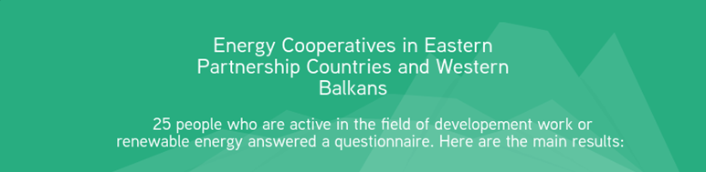
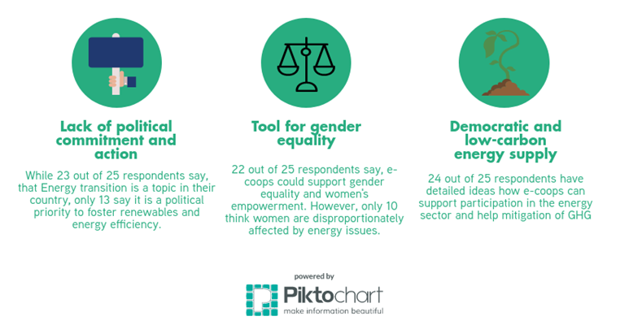

Slide 8
Energy Communities and Cooperatives
Citizens and community participate in whole value chain
Implementing and expanding renewable and decentralized energy systems
Needs assessment
Awareness raising / presenting good practices
Knowledge management / training
Improving value chain (e.g. productive use for agro or diary products)
Access to finance / unlocking local and private capital
Market development
Women’s and youth empowerment
Manufacture
Plan
Funding
Install
Grid
Operate
Maintain
Consume & Added Value
Using citizen’s investments to de-risk
Local citizens, priv.sector, SACCOs, SMEs, coops
National & intern. firm,
local production of stoves
Planning process with LC leaders and
districts
Trained Technicians
SMEs
Utilities, SMEs, comm-unities
Comm-unities, SMEs, Utilities
Citizens, SMEs, Utilities
Citizens, SMEs, Municip.
Empowered and sustainable energy Communities can take over different roles of the energy value chain

Slide 9
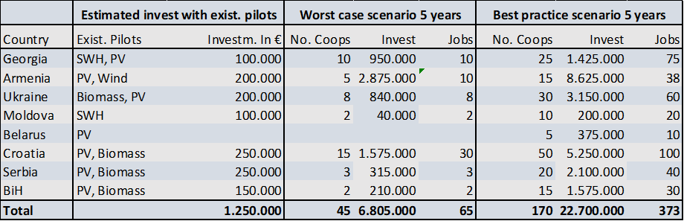
Funding potential of community energy
  Local capital unlocked
  De-risking with local equity
  Meeting local development and national strategies
  Capacity building for managing funds and projects
Source: act alliance eu 2017: Analysis of climate reporting of EU

Slide 10
Energy communities and cooperatives
  Mobilize people with participatory approach: de-monopolization and democratization
  Lift barriers to new projects
  Upscale efficient mitigation measures meeting local priorities and national strategies
  Build and establish trustful partnerships between actors
  Create decent jobs for youth, women and men
  Integrate gender tools like gender budgeting, empowerment, in-kind-contribution
  De-risk projects with local leverage capital, knowledge and joint implementation
  Unlock private capital and match countries/communities needs for climate solutions
  Foster peace and strengthen social and democratic relations
  Catalytic funding schemes, in combination with innovative grant-based financing
  Many small projects deliver big impact

Slide 11
Appropriate technologies?
Infrastructures of solar electric production for remote areas
Solar-home systems combining solar energy, micro-finance and
After sales services
Business opportunities with solar systems
Smart Hydro Power
Battery systems for
Grid and off-grid
Solar Water
Heaters
Biogas plant- bamboo weaving
Water tank bamboo weaving

Slide 12





Good practice
Georgian energy cooperatives and SMEs
Independent business advisor
Fiancing model with
three-party loan contract
Active citizens as cooperative members, employees,
energy entrepreneurs and investors
Owner
Households
5. Subsidies
Transformative potential through ecological, economic and social benefits
2. Purchase
contract
6. Installation
3. Loan contract
Georgian energy cooperatives; each share 2.500 €
7. Interest and payback
Green Energy
Switch to
the Sun
R-Cleen Energy
Further SMEs & coops
4. Loan amount
1. Cooperation
Umbrella cooperative – Clean Energy
Material purchase and production, economies of scale
Financing and operation of production facilities
Guarantee of quality through certification
Marketing and trainings, political commitment for renewable energy
Credo Bank
Contracts
Cash Flows
Installation / service
International investors
Each share 2.500 €
Notes:
Combination of SMEs,
Microinsurance
Gender
Etc.

Slide 13
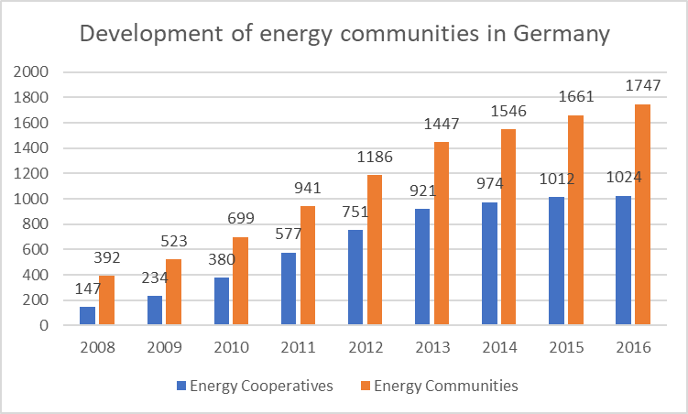
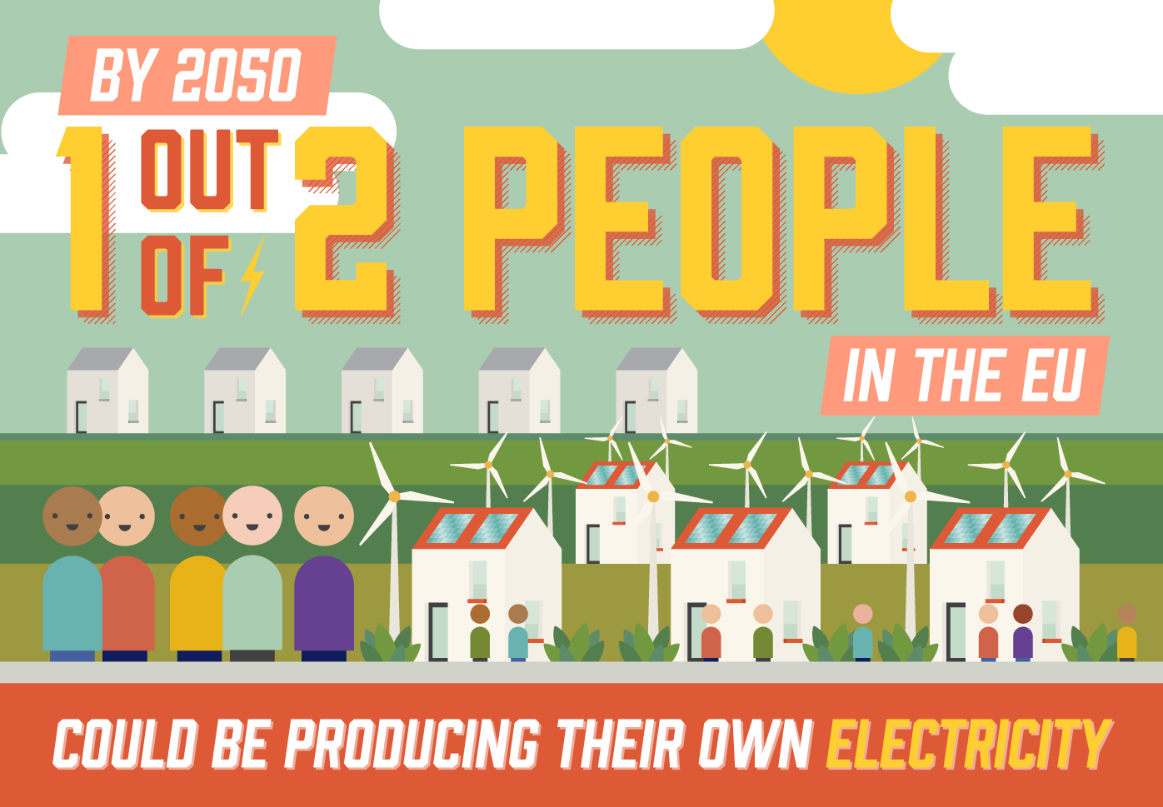
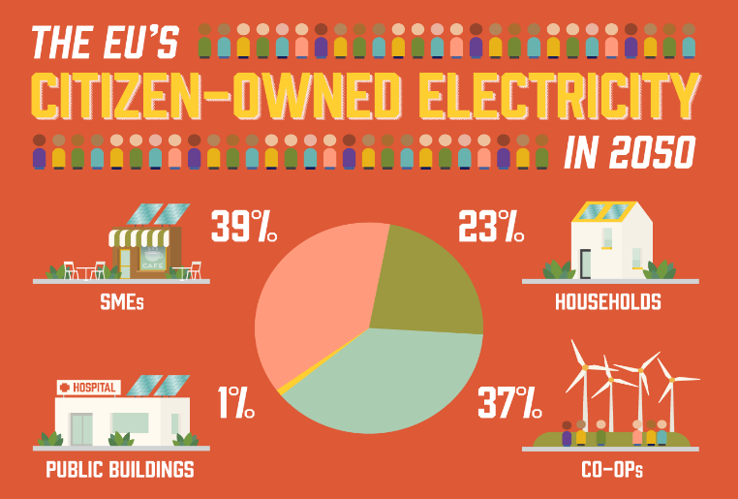
“Putting citizens at the heart of the energy transition”
Citizens = most important impetus for the energy turnaround
Energy communities/SMEs as democratic and realistic way of funding.
264 millions of EU citizens could produce their own electricity by 2050
Cooperatives could contribute 37% of the electricity produced
50% of electricity can be produced locally by private households, SMEs, cooperatives, municipalities till 2050
Source: Report “Putting citizens at the heart of the energy transition” (REScoop 2016)

Slide 14
Recommendations
Adopt enabling policies:
  Strengthen the right for prosumers - legal framework – environment for civil society
Ambitious targets:
  Establish binding targets for RE and community energy – in 2030 national renewable energy action plans – meeting SDGs
  International goals for local finance
  Ensure funding:
  Encourage innovative financing solutions for energy community projects.
  Provide financial support for preliminary work and implementation
Clear communication:
Ensure that the true benefits of citizen’s energy are communicated transparently
Highlight and scale up successful pilot projects
Local level:
Cross sectoral approach
Providing infrastructure for RE projects
Recommendations for Civil Society and citizens:
it’s possible - let’s do it!

Slide 15
Energy Communities
Combination of civic participation and decentralized energy generation
Small energy production cooperatives at the local level
Producing for their members’ or their community’s needs
Very successful large cooperatives, at regional and national levels.
SMEs/ COOPERATIVEs
e.g. energy producer, energy consumer, producer &consumer, trade energy
ENERGY SOURCE
e.g. solar, wind, photovoltaic, bioenergy, geothermal
SERVICE ALONG VALUE CHAIN
e.g. community-led, efficiency, farmer coops, grid, consulting, planning, power stations

Slide 16
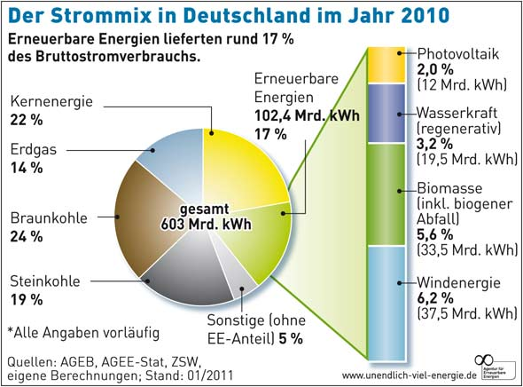
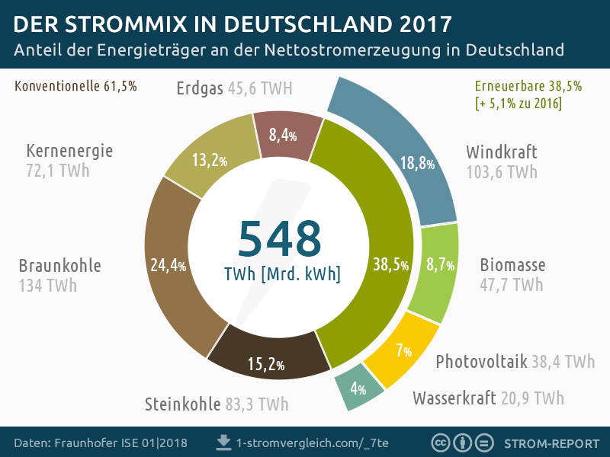
Electricity Mix in
Germany in 2010 and 2017
17% 38,5%
Electricity Mix in Germany 2010
17% Renewable Energy
Photovoltaics
2%
RE
Nuclear
22%
Water
3,2%
Gas
14%
Biomass
5,6%
Biomass
Brown Coal
24%
Black Coal
19%
Others
5%
Electricity Mix in Germany 2017
38,5% Renewable Energy
Others
5,2%
Water
3,2%
Gas
12,4%
Photovoltaics
5,9%
Black Coal
17,2%
RE
Biomass
7,9%
Nuclear
13,1%
Wind
(Offshore)
1,9%
Brown Coal
23,1%
Wind
(Onshore)
10%
Notes:
Wind and PV have skyprocked during the last decade. The new EEG puts flexible caps on RE capacities to better control the futeur development.

Slide 17
Citizen’s energy in EU
Report “Putting citizens at the heart of the energy transition” (REScoop 2016) estimates 264 millions of EU citizens could be producing their own electricity by 2050
Cooperatives could contribute 37% of the electricity produced by energy citizens
50% of electricity can be produced locally by private households, SMEs, cooperatives, municipalities till 2050

Slide 18
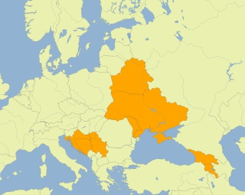
Research question and methodology
Estimating the potential of energy cooperatives to
meet emission targets,
supply society with decentralized, affordable, safe and renewable energy,
offer gender-sensitive participation opportunities
in Eastern Europe and the Western Balkans.
Target group: Political decision makers, Energy and community activists
Desk research and two-step data collection (QNR followed by expert interviews) exploring:
              national climate and energy policies,
              degree of gender equality,
              situation of civil society,
              legal framework for cooperatives and existing pilots,
              viable business models and suitable RE technology
Eight countries examined: Georgia, Armenia, Ukraine, Moldova, Belarus, Croatia, Serbia and Bosnia and Herzegovina

Slide 19
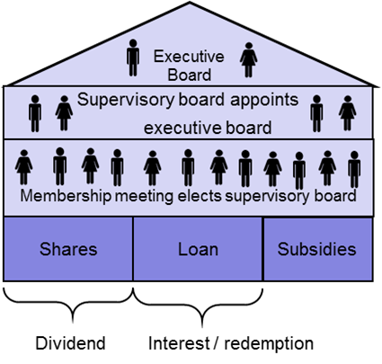
Terminology - citizen’s and community energy
Combination of civic participation and decentralized energy generation (based on RE), combined with energy efficiency.
Citizen’s energy or community energy organised by:
Citizens or individuals – prosumers (net metering)
Cities and municipalities
SME, e.g. energy cooperatives or communities
Citizen Public partnership
ESCO model for public sector
Crowdfunding (investment or donation based
Energy cooperatives: established for the purpose of producing and distributing energy, mostly from RE.
offer a suitable model to plan, finance and implement
RE projects.
decentralized alternative to the
existing fossil and wood energy industry.
allow a de-monopolization and democratization
of expert knowledge and the entrance of new actors
Unlock private capital with and match countries and
communities needs for climate solutions

Slide 20




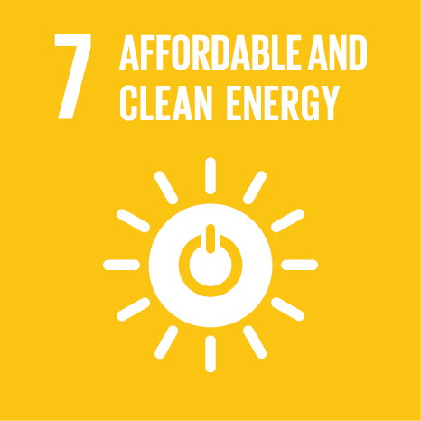




Transformative potential: Community
Energy as flexible and catalytic climate funding
Poverty reduction
Improved living conditions
Enhanced livelihood opportunities
Alternatives to labour intensive energy supply
Strengthening capacity on energy, climate, resilient structures
Training, orientation, guidelines for resource persons, staff, ToT and users
Gender sensitive energy supply
Rural households have access to sustainable energy technologies
& reduced costs and effort, more comfort and better health and less unsustainable energy need
Social benefits
Time saved from collecting biomass
Reduction in household drudgery for women
Increased participation
Productive use and creating business models for women and vulnerable groups
Skills training, financial mechanism, business models for access and efficiency
Improved health and education
Reduction in respiratory problems
Improved education due to access to electricity
New energy technology development and improvement
Training and capacity building on smart grid elements
Exclusionary practices
Women‘s role in energy value chain recognized
Access of poor to affordable energy
Access to human and social capital, more female decision makers
Transform and develop markets, projects behaviour of users and households
Policy support and changing behaviour, promoting renewable energy supply
Inclusive and improved situation
Better infrastructure
Sustainable growth
Better jobs
Climate protection

Slide 21
Climate financing
Need the financing to let citizens complete their plans to build climate-resilient infrastructure and tap into the abundant renewable-energy resources.
Encouraging socially sound climate projects, is not just more money. It is also lifting barriers to new projects and making investments less risky and more palatable for small investors (like private households) and private sector.
attract cooperation from the private sector and small scale projects by using public funds as risk capital to finance projects in emerging markets and economies in transition.
Support regions, cities and businesses in their transition to a low-carbon future with
      Financing
Advisory and planning
Knowledge sharing
Matchen countries’ or communities’ needs to the most appropriate source of climate finance.
Providing risk guarantees
Flexible and catalytic funding are as important as large scale investments and there is demand for both small amounts of easily accessible finance

Slide 22
Transformative potential of citizen’s energy
Joint effort shows opportunities to act and breaking out of feeling helpless against problems like climate protection, corruption, etc.
  Bringing democracy to the energy sector, fostering decentralized RE production and wider diffusion of new energy structures.
Creating energy resilient communities, not depending on foreign resources
Educating citizens towards aware and active energy citizens: consumers, producers, investors, etc.
Offering a space to develop new ideas and systems of energy supply and enabling social innovation
Allow EVERYBODY, e.g. women, men, youth, etc. to contribute
“Affordable and safe energy is available for you”.
Showing best practice and successful pilots from bottom up and good appropriate legal framework from top down will bring social and cultural change.

Slide 23
Which support is needed
To start coops and projects
Information and experience exchange with other countries
Trainings on technologies, business models, leadership, entrepreneurship, marketing
Concrete workshop with national and international stakeholders and experts
Administrative support from authorities, municipalities, politicians
Financial support to set up the structure
To operate coops and citizen’s energy companies
Focus on marketing to increase the demand
Ongoing dialogue with investors and banks
Ongoing improvement of technology
Training and qualification for initiators and actors
Discussion and round tables with policy makers
Support of women through leadership trainings and ender trainings for the whole community
Public relations and visibility of the projects.
Information hub for energy cooperatives and projects on national and local level

Slide 24
How much climate funding is needed
The UNEP Finance Initiative estimates that the costs of the transition to low-carbon and climate-resilient economies will need investment at an order of magnitude of at least USD 60 trillion, from now until 2050.
This includes approximately USD 35 trillion to decarbonize, through renewable energy and energy efficiency, the world’s energy system;
USD 15 trillion to adapt manmade infrastructure to changing meteorological conditions;
and 2 USD trillion to reorganize global land-use is ways that meet growing demands for agricultural commodities while stopping tropical deforestation
Source: http://www.unepfi.org/climate-change/ climate-change/

Slide 25
