Slide 1
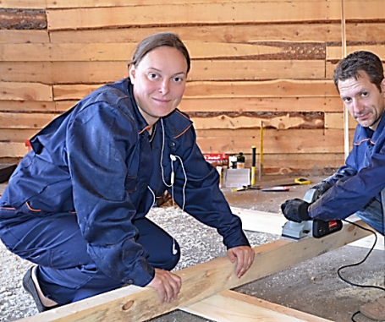
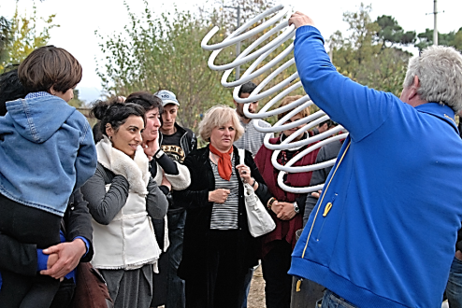
Women in Energy Cooperatives:
Advancing Gender Equality
While unlocking local climate finance
Nino Margvelashvili
May 7, 2018, Bonn

Slide 2
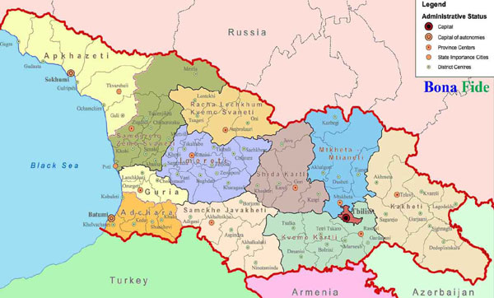
Geographic distribution of cooperatives
5 pilot regions, 4 energy cooperatives established in 2016
1 umbrella cooperative established in 2017 in Tbilisi
Khobi
Khoni
Mtskheta
Sagaredjo
Akhaltsikhe

Slide 3
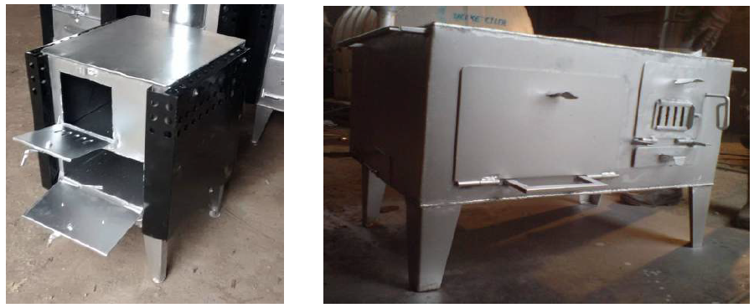
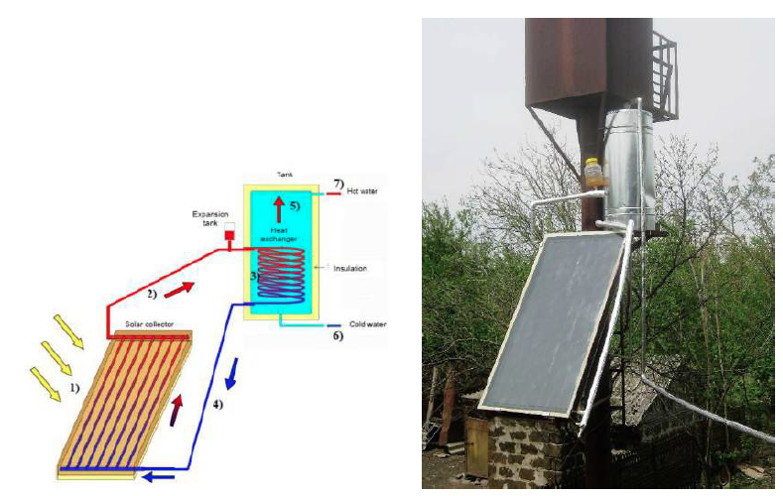
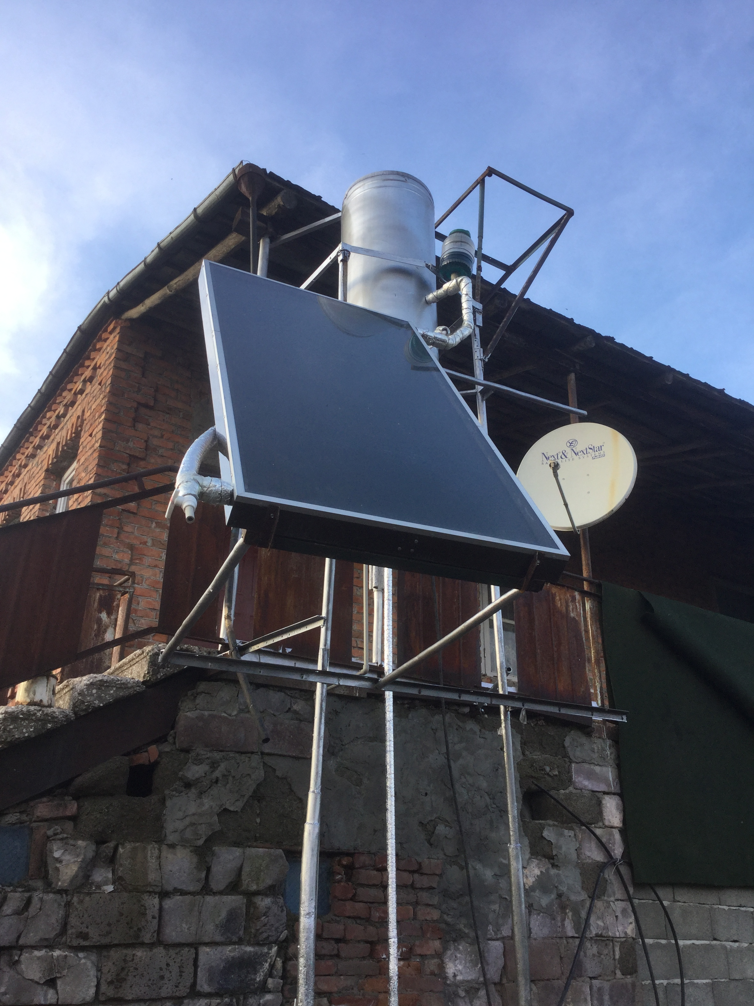
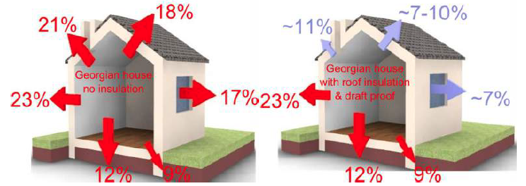
Sustainable Energy Services Solar heaters, efficient stoves, insulation
Household market
SME market: tourism, agriculture

Slide 4
USPs Unique Selling Points
Produced in Georgia, the only local production in the country
Full cycle – installation, maintenance, finance
Price is affordable and 3 times less than average market (imported)
Access to loans, easy and free
Terms: 3 years guarantee, after purchase services – high trust of customer

Slide 5
Georgian energy cooperative
Independent business advisor
Financing model with
three-party loan contract
Active citizens as cooperative members, employees,
energy entrepreneurs and investors
Owner
Households
5. Subsidies
Transformative potential through ecological, economic and social benefits
2. Purchase
contract
6. Installation
3. Loan contract
Georgian energy cooperatives
7. Interest and payback
Green Energy
Zrudi
Switch to
the Sun
R-Cleen Energy
Further coops
4. Loan amount
1. Cooperation
Bank
Umbrella cooperative
Material purchase and production, economies of scale
Financing and operation of production facilities
Guarantee of quality through certification
Marketing and trainings, political commitment for renewable energy
Managing director:
N.Margvelashvili
Contracts
Cash Flows
Installation / Service
National and International investors
Each share 2.500 €
Notes:
Umbrella cooperative
Membership of all local energy cooperatives
40% of women in bodies, required by charter
Local and international investments
Operation of production facility
Certification mechanism for technologies
Economies of scale by purchasing larger amounts of materials
Pools resources for the production and the purchase of technologies
Bundling of economic and technical know-how on energy technologies
Provision of marketing and training for local e-coops
Commitment for sustainable, decentralized and renewable energy policy on a local level by formulating concrete demands
5

Slide 6
Gender-just energy cooperatives
Equal access to women in whole energy value chain: technologies, jobs, funding, dividend
Reduce workload: save cost and time
Provides control over energy production and consumption
Foster women’s empowerment & leadership
Engage for cooperative gender and energy policy
Beneficiary and people-centred approach pays particular attention to small-scale and community-based actions, where women are over-represented
€
Notes:
Business model:
Construction, implementing, selling of solar collectors
Marketing of technologies and awareness raising
Capacity building and continuous development of technologies
Policy and advocacy for renewable energy policy and public participation

Slide 7
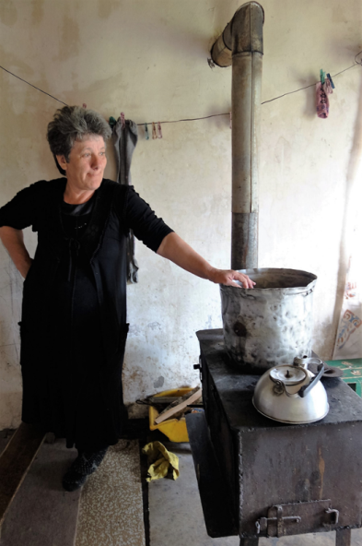
Women in Georgia
Women are
energy managers...but:
Unpaid & unappreaciated
workload
Lack of awareness on
inequalities
Inadequate structures for
women‘s participation
Notes:
Women contribute to their societies and take over responsibility on community level
These contributions are neither fully recognised and appreciated nor paid.
Women’s attitudes and solutions are often not represented and therefore marginalized.
Women’s economic contributions still face the challenges of quality production, access to markets, market-driven prices and fair legislation.
Women are also effective actors or agents of change in relation to mitigation and adaption
Strong body of knowledge and expertise that can be used in climate change mitigation, disaster reduction and adaption strategies
Good management of natural resources and households
Women’s responsibilities in households and communities enable them well to contribute to livelihood strategies adapted to changing environmental realities (collectors of fuels and users of energy)
Clear understanding of strategies needed at local level
Leadership role in early warning systems and after disasters (take care for sicks and elderly)
Able to mobilize communities
Share information
Choose less polluting energy, userfriendly, affordable, sustainable

Slide 8
Energy access is not gender-neutral
Energy poverty has gender dimensions
No access to affordable and safe energy
Indoor pollution affects mostly health of women/children
Low income households live in less energy efficient houses
Energy services and programs can promote women’s skills and employment
Women are still not represented equally in energy leadership positions
Energy policies and programs need to be gender sensitive
Women are most primary energy managers but not decision makers
Notes:
: Women have less decision making power in this powerful sector. Their attitudes and solutions are marginalized
Access to energy is key to social development, economic growth, environmental sustainability and to achieve the Millennium Development Goals
Poverty:
Approximately 2 billion people throughout the world do not have electricity. About the same number rely on traditional fuels, such as wood, charcoal, dung, and agricultural residues, for cooking and heating. Grid-based electrical power does not reach many rural and poor urban areas, nor is there adequate distribution of gas or other cooking and heating fuels
Women often experience energy poverty in Eastern and South East Europe
This impact negatively all their activities and increases their burden and stick to gender roles
Health: are also exposed to a variety of health hazards from cooking over poorly ventilated indoor fires also suffer from health problems related to gathering and using traditional fuels.
They, including respiratory infections, cancers, and eye diseases. Smoke from poorly ventilated indoor fires accounts for close to 2 million premature deaths per year
Many women and girls also suffer from health problems relating to using traditional fuels
Increased access to electricity is needed, through extension of power grids as well as installation of decentralised small-scale energy systems powered by diesel fuel or by renewable technologies using solar, micro-hydro, wind, or biomass resources.
is needed to provide affordable alternatives to traditional biomass-based cooking and heating fuels
Because of their traditional responsibilities for collecting fuel and water, in many developing countries women and girls would benefit the most from access to improved energy services.
The time and physical effort expended by women and girls in gathering fuel and carrying water seriously limits their ability to engage in educational and income-generating activities

Slide 9
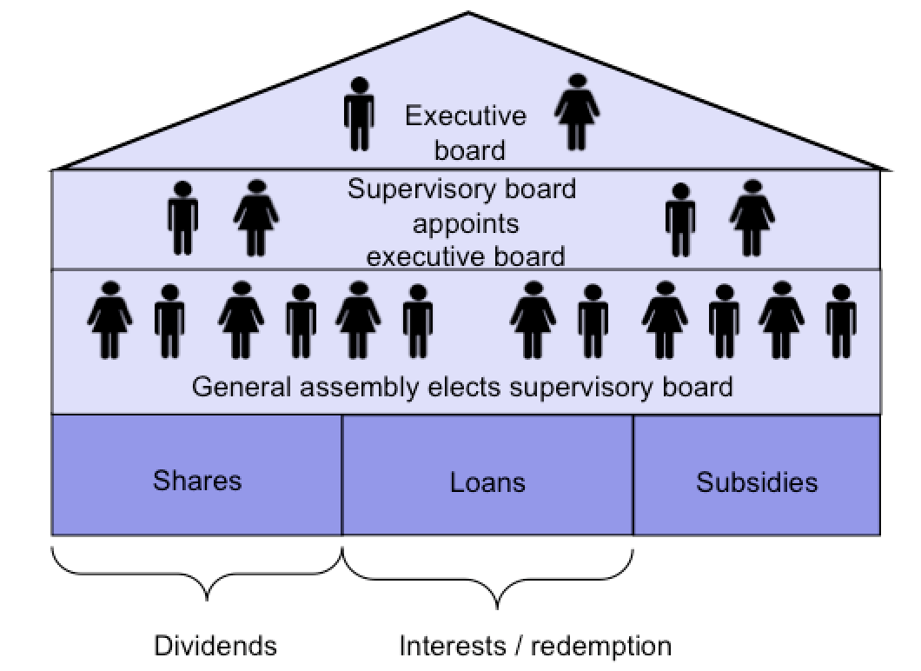
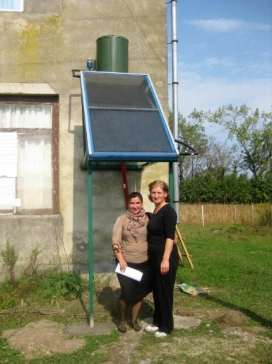
Increase women‘s participation
through clear gender strategies:
Quota in board (min. 40% of positions female) and stimulation of women membership
Leadership training for women in management
Awareness raising on gender and the importance of women equal particiation for women and men

Slide 10
Women and energy
Empowerment Dimensions
Political
Social
Economic
Cultural

Slide 11
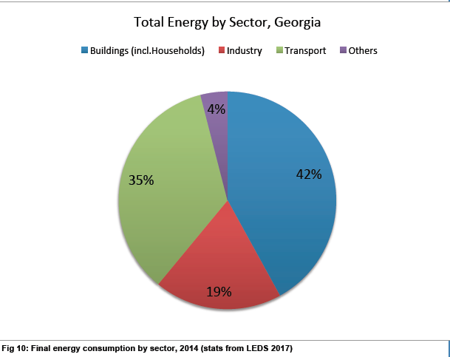
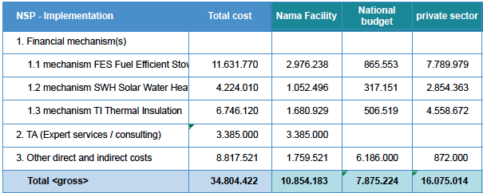
Climate Finance for acceleration
400.000 households need to shift from firewood to renewable energy
Climate finance – providing partial subsidies and reducing cost of finance, to speed up installations

Slide 12
Questions or comments?
Thank you for your attention!
nino.margvelashvili@heliotech.ge
www.wecf.eu
Twitter: #WECF_INT

